Slide 1


Submitted by:
Sudhanshu Kumar

Slide 2
BUSINESS PROBLEM FRAMING
The proliferation of social media enables people to express their opinions widely online. However, at the same time, this has resulted in the emergence of conflict and hate, making online environments uninviting for users. Although researchers have found that hate is a problem across multiple platforms, there is a lack of models for online hate detection.
Online hate, described as abusive language, aggression, cyberbullying, hatefulness and many others has been identified as a major threat on online social media platforms. Social media platforms are the most prominent grounds for such toxic behaviour.
There has been a remarkable increase in the cases of cyberbullying and trolls on various social media platforms. Many celebrities and influences are facing backlashes from people and have to come across hateful and

Slide 3
BUSINESS PROBLEM FRAMING
offensive comments. This can take a toll on anyone and affect them mentally
leading to depression, mental illness, self-hatred and suicidal thoughts.
Internet comments are bastions of hatred and vitriol. While online anonymity has provided a new outlet for aggression and hate speech, machine learning can be used to fight it. The problem we sought to solve was the tagging of internet comments that are aggressive towards other users. This means that insults to third parties such as celebrities will be tagged as unoffensive, but “u are an idiot” is clearly offensive.
Our goal is to build a prototype of online hate and abuse comment classifier which can used to classify hate and offensive comments so that it can be controlled and restricted from spreading hatred and cyberbullying.

Slide 4
ANALYTICAL PROBLEM FRAMING
I have used the TF-IDF to vectorize the words so that machine can understand the words.
TF – Term Frequency (the number of times the words/terms appear in a document.)
IDF - Inverse Document Frequency. (If a word appears in all documents, then it may not play such a big part in differentiating between the documents. IDF is a way of identifying such words)
Document Frequency(term t) = number of documents with the term t/ total number of documents = d(t)/n
Inverse Document Frequency = total number of documents / number of documents with the term t = n / d(t)

Slide 5
DATA SET
The data set includes:
Malignant: It is the Label column, which includes values 0 and 1, denoting if the comment is malignant or not.
Highly Malignant: It denotes comments that are highly malignant and hurtful.
Rude: It denotes comments that are very rude and offensive.
Threat: It contains indication of the comments that are giving any threat to someone.
Abuse: It is for comments that are abusive in nature.

Slide 6
DATA SET
Loathe: It describes the comments which are hateful and loathing in nature.
ID: It includes unique Ids associated with each comment text given.
Comment text: This column contains the comments extracted from various social media platforms.

Slide 7
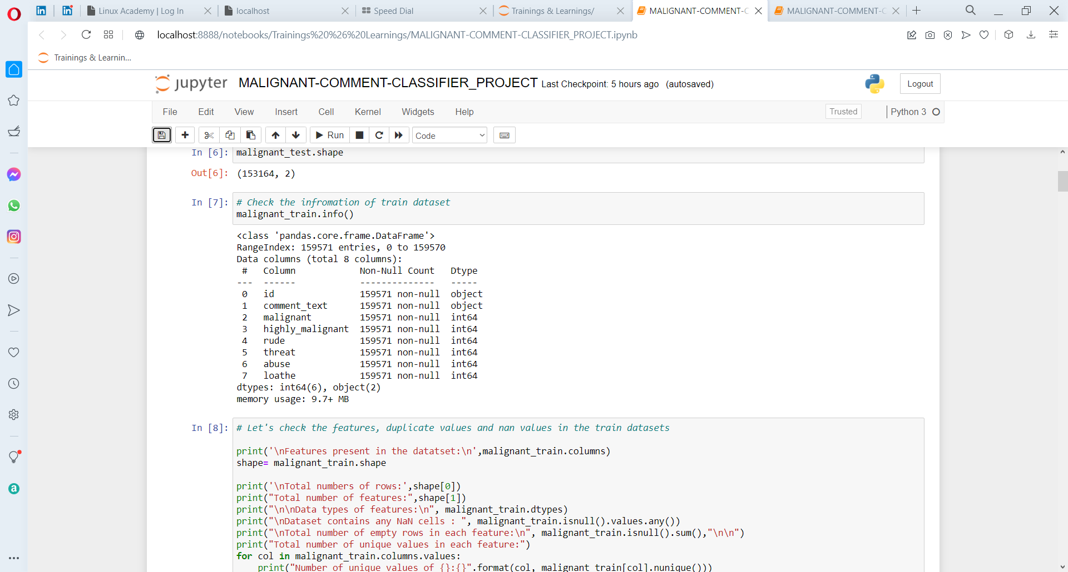
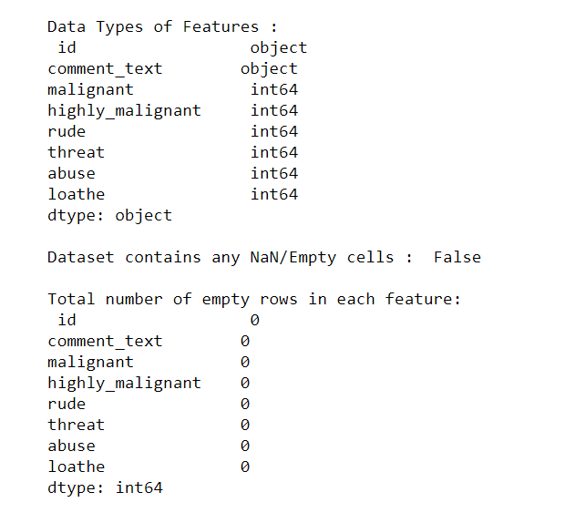
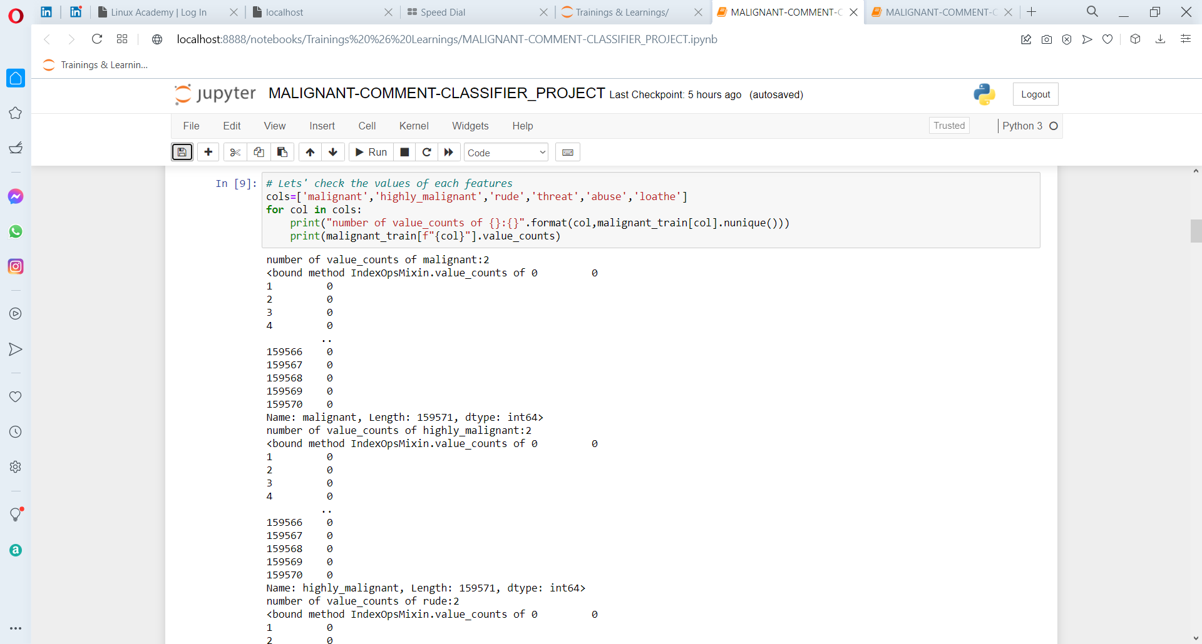
DATA SET

Slide 8

DATA PRE-PROCESSING
Cleaning the data set

Slide 9
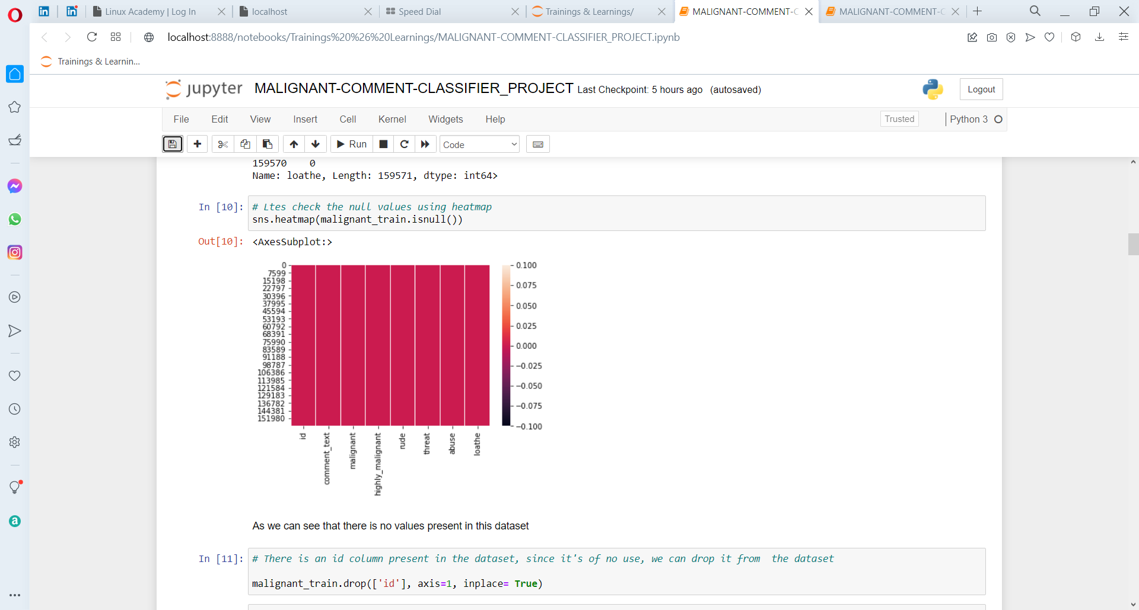
DATA PRE- PROCESSING
Checking for Null Values

Slide 10
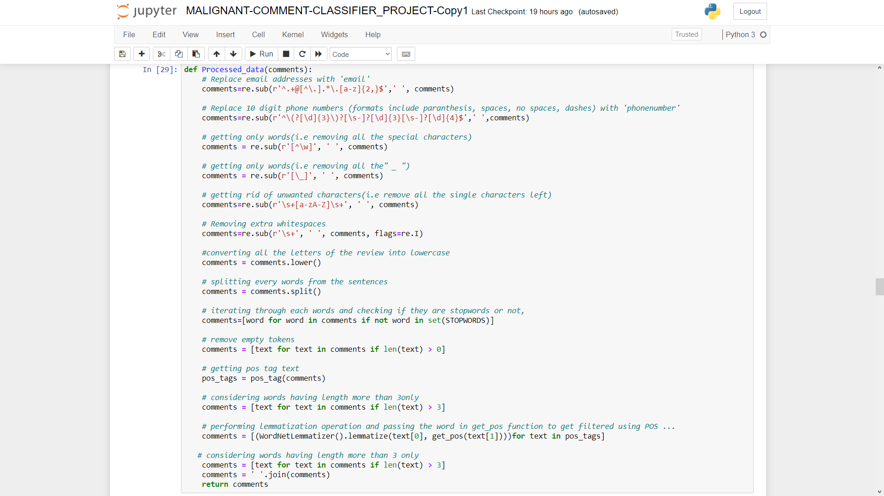
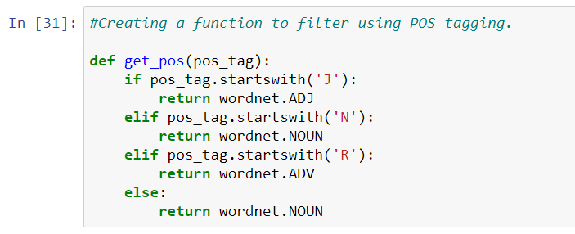

Slide 11
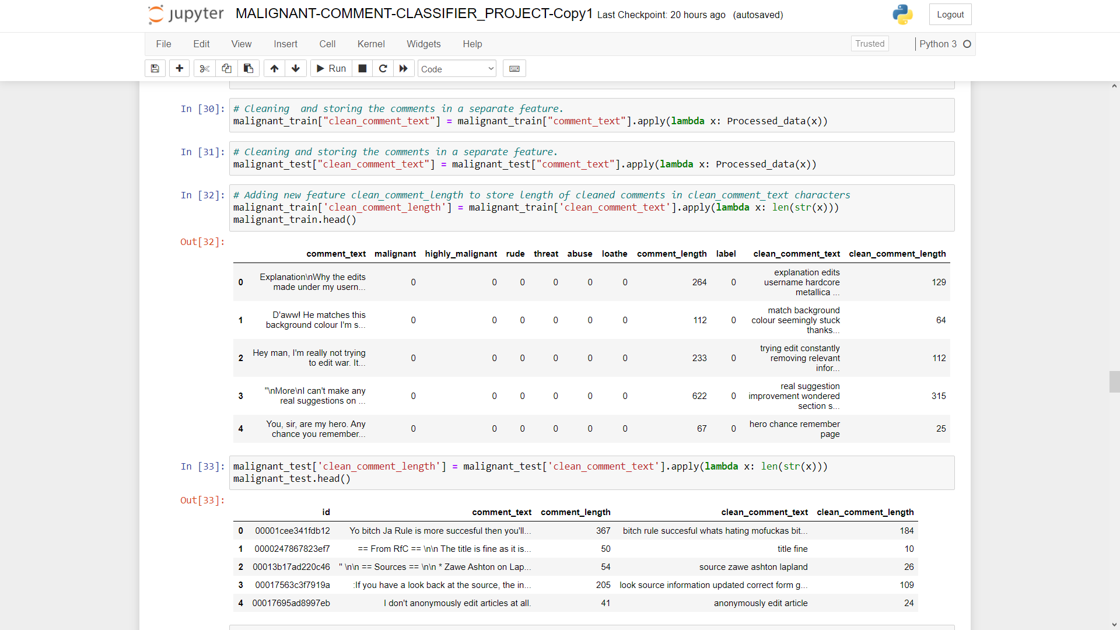

Slide 12

EXPLORATORY DATA ANALYSIS (EDA)

Slide 13
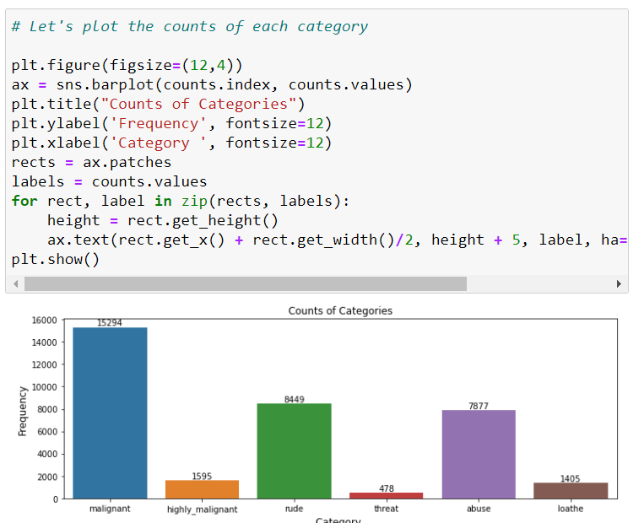
EXPLORATORY DATA ANALYSIS (EDA)

Slide 14
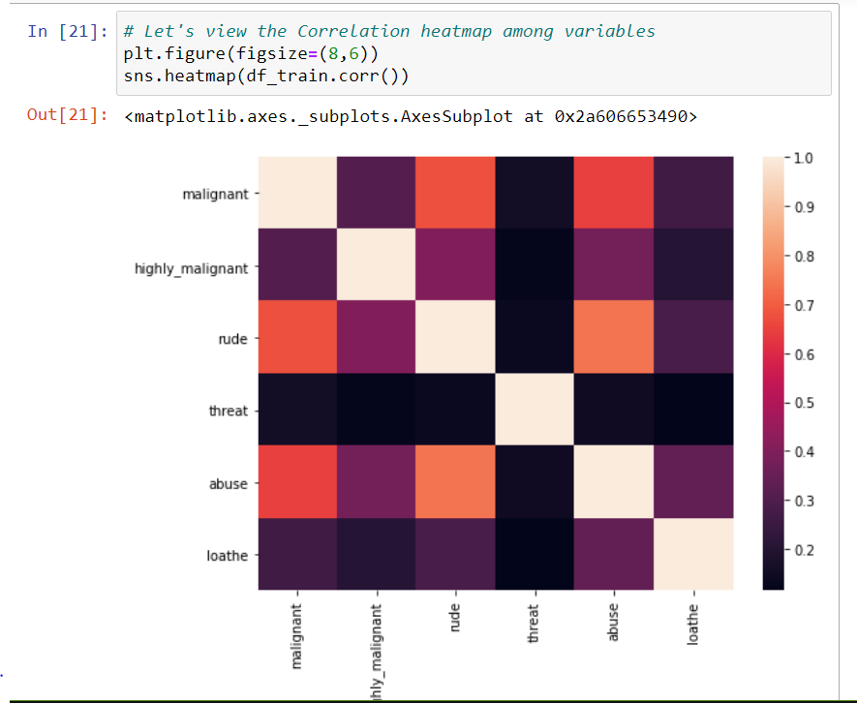
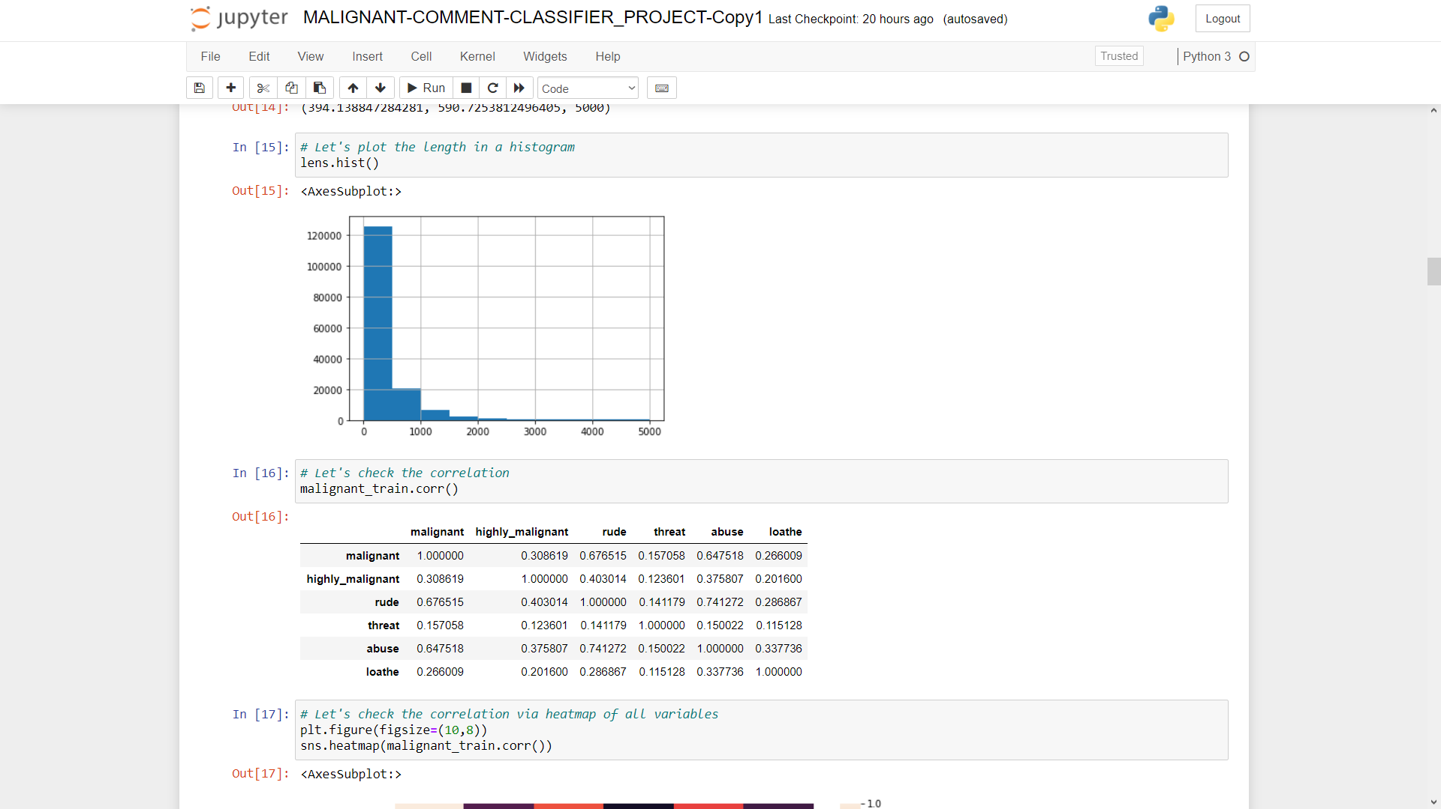

Slide 15
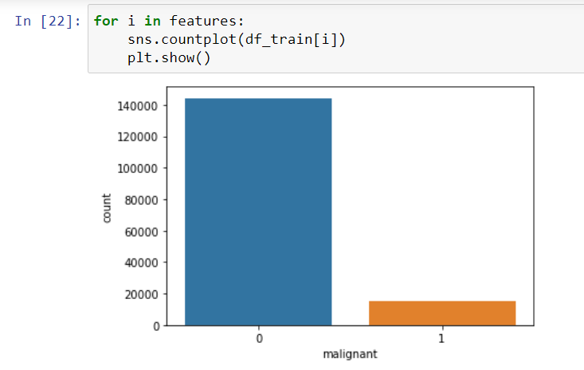
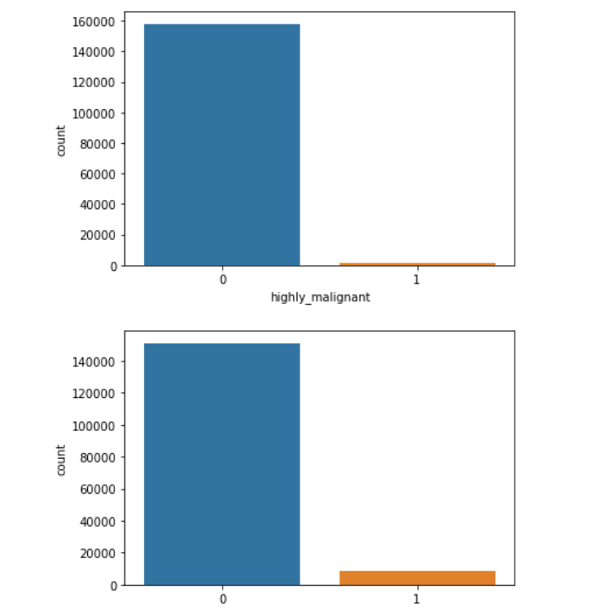
for i in features:
sns.countplot(malignant_train[i])
plt.show()

Slide 16
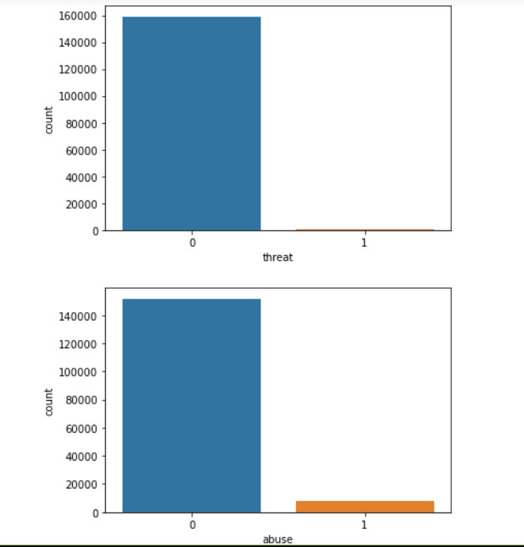
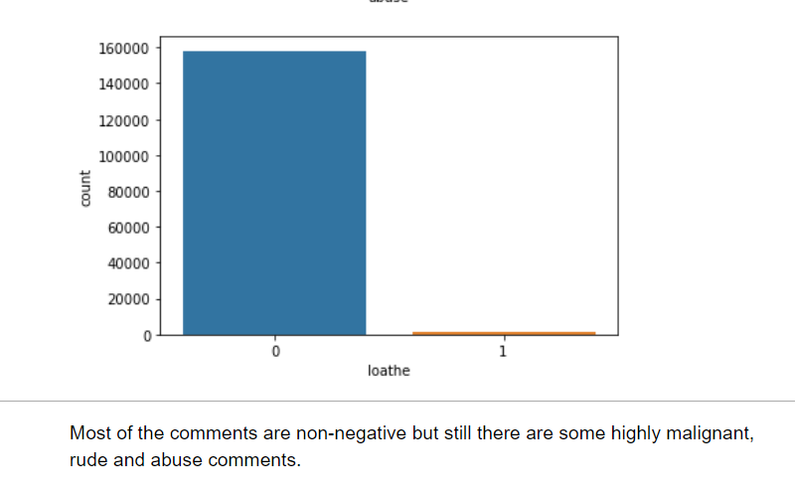
From the visualization, we can see that no. of positive comments are more than negative comments, but still there are some highly malignant , rude and abuse comments.

Slide 17
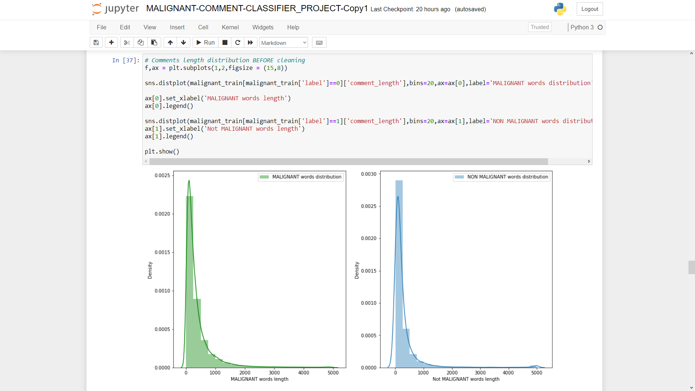

Slide 18
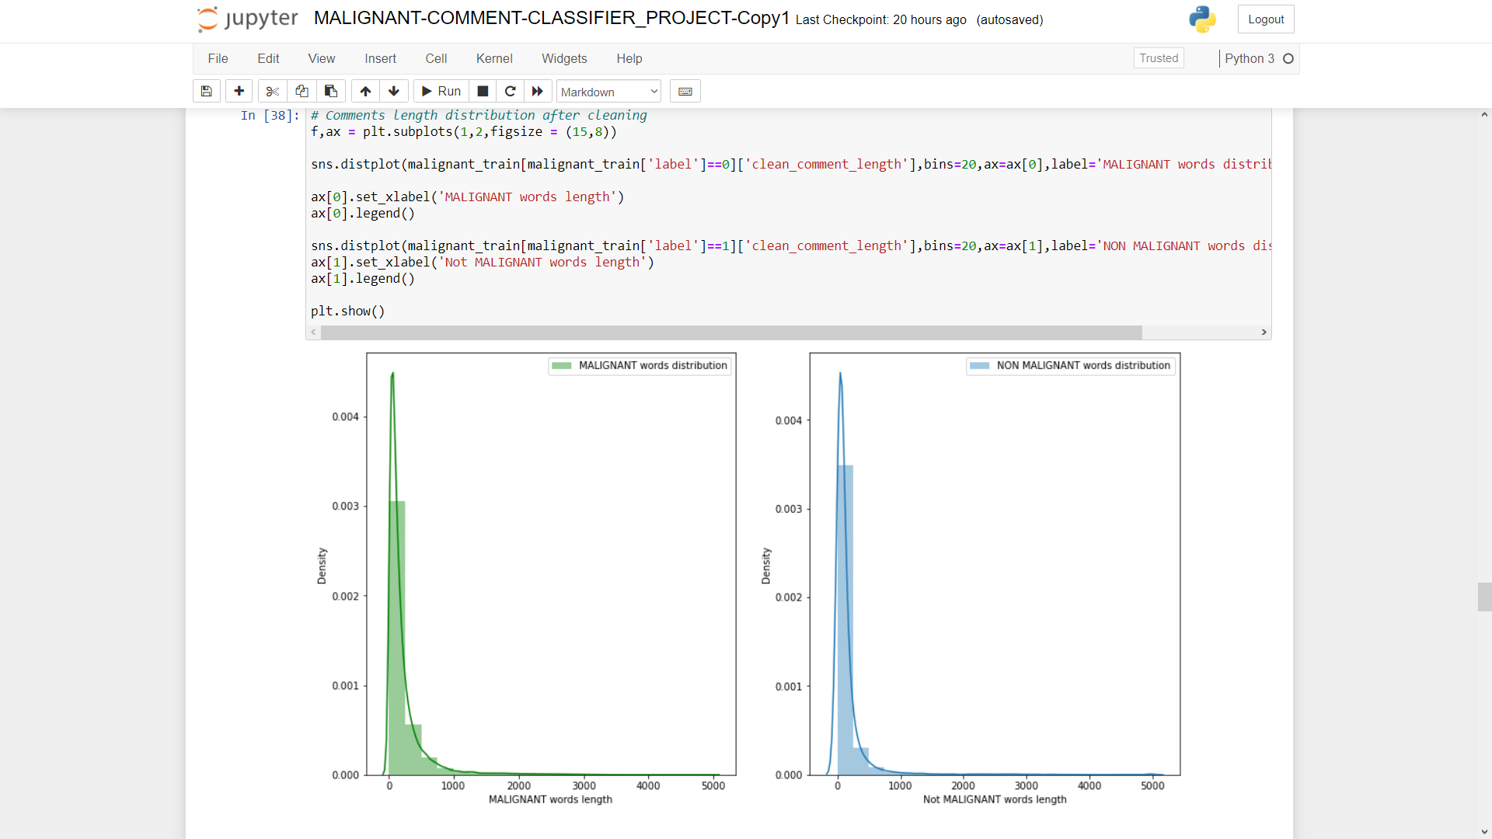

Slide 19

WORD-CLOUDS

Slide 20
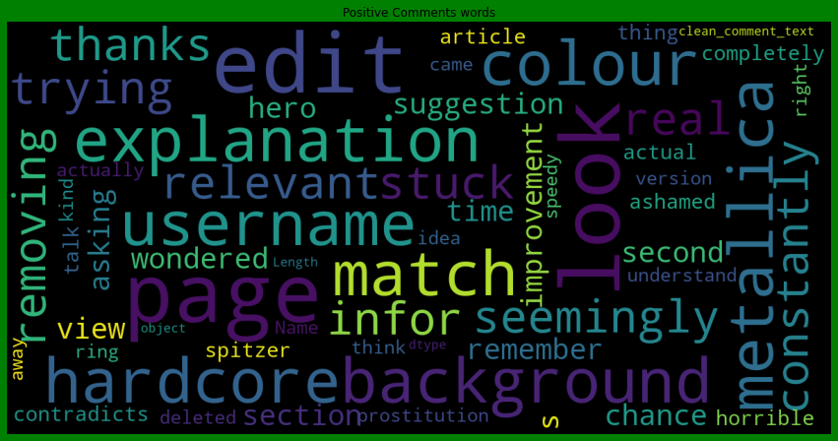
# Non-Negative/Good Comments - in training data

Slide 21
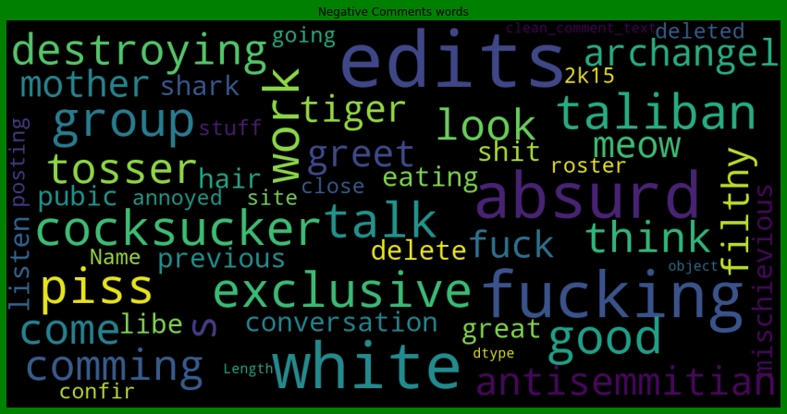
# Negative Comments - in training data

Slide 22
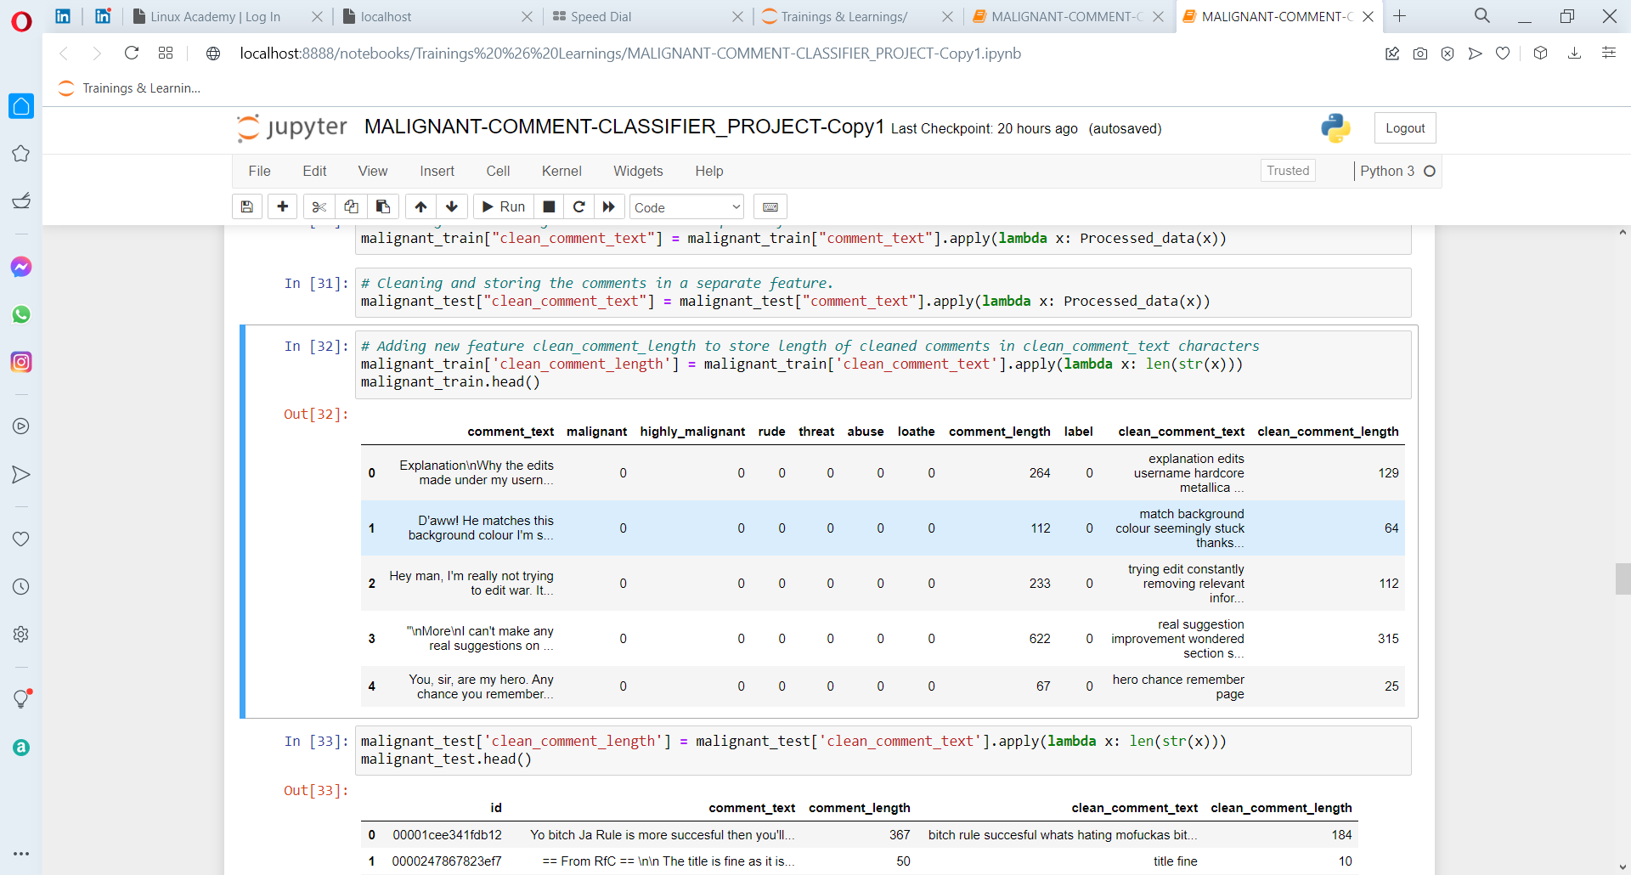
ADDED NEW FEATURE – COMMENT LABEL

Slide 23
Model Building

Slide 24
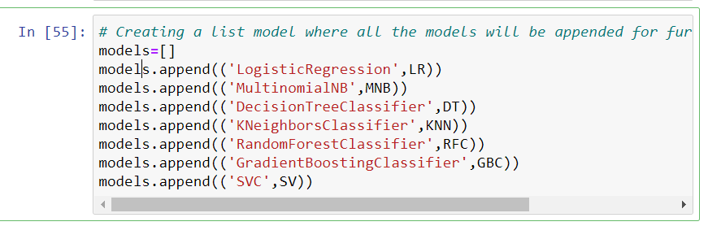
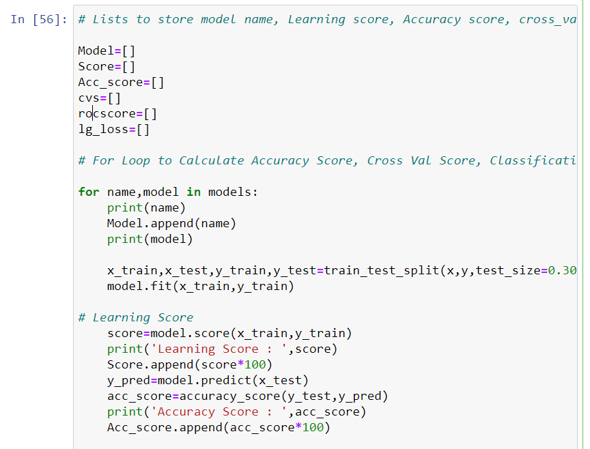
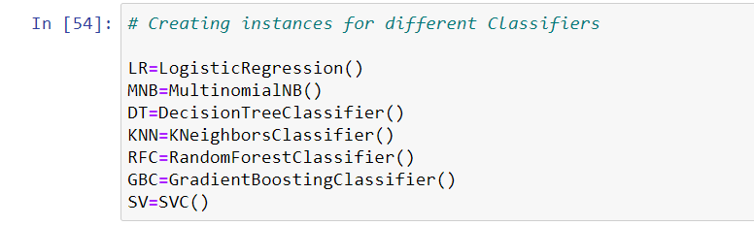
MODEL PREPRATION
The “clean comment text” feature has a notable reduction in the number of characters.

Slide 25
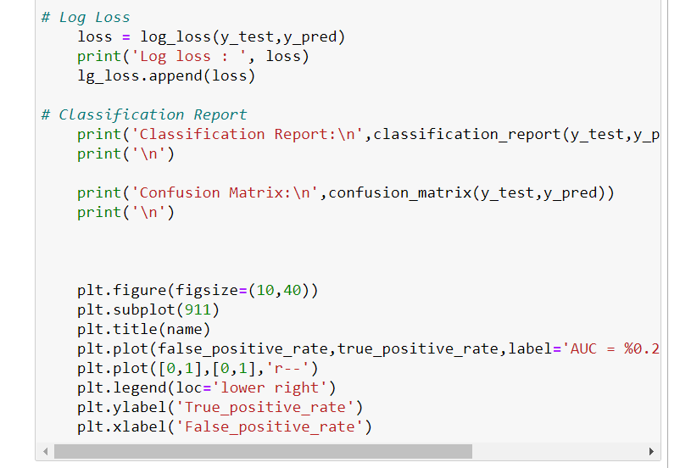
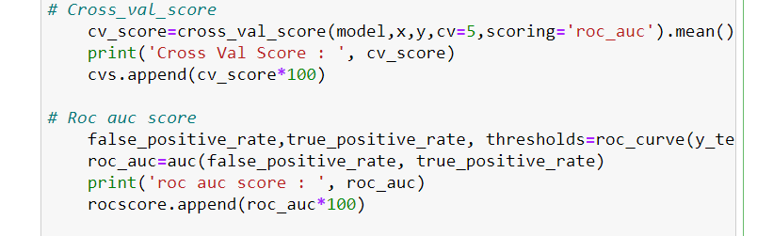
MODEL PREPRATION

Slide 26
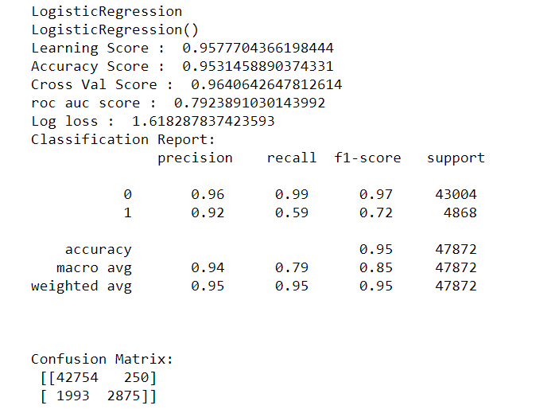
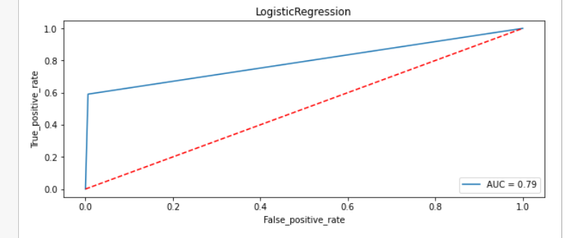
MODEL OUTPUT

Slide 27
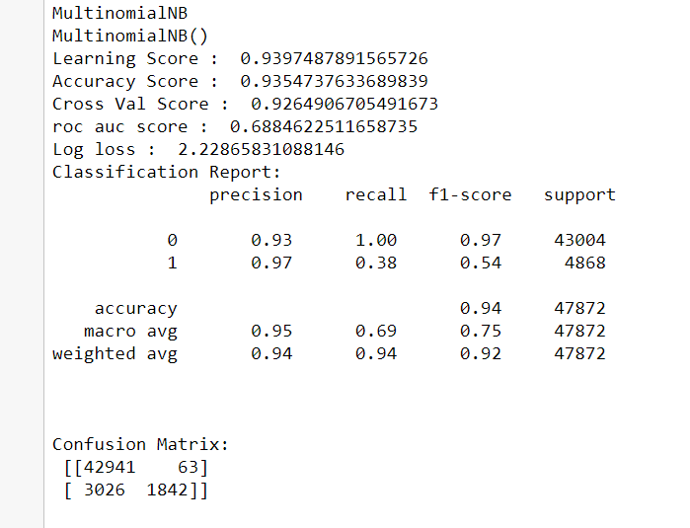
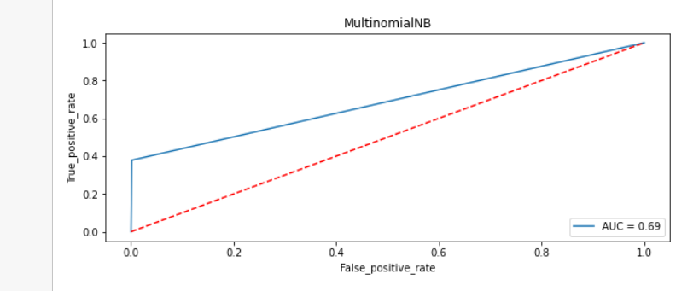
MODEL OUTPUT

Slide 28
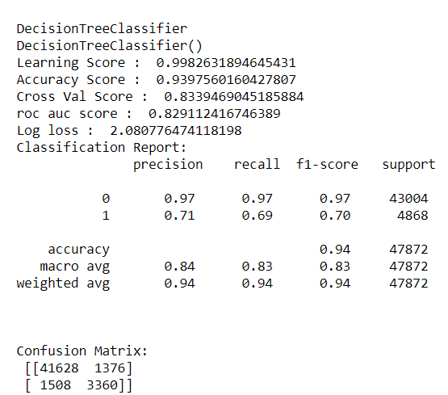
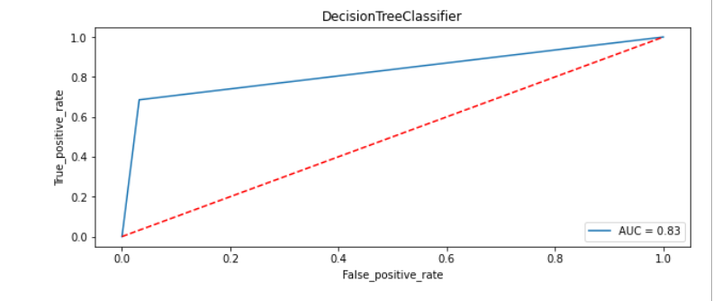
MODEL OUTPUT

Slide 29
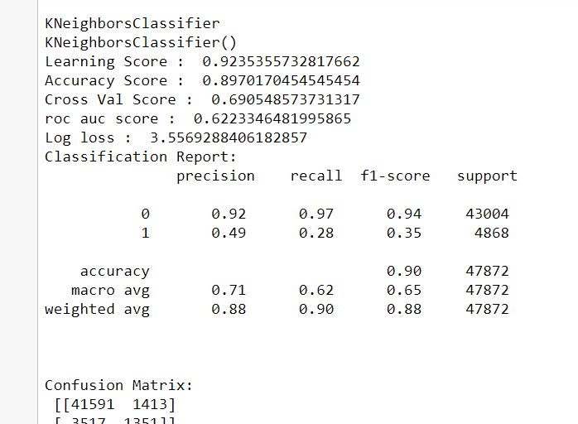
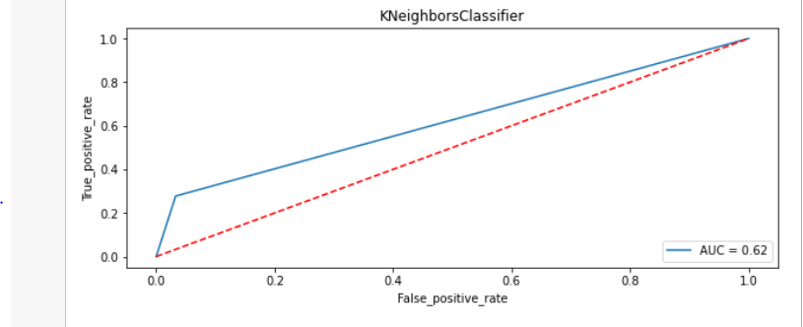
MODEL OUTPUT

Slide 30
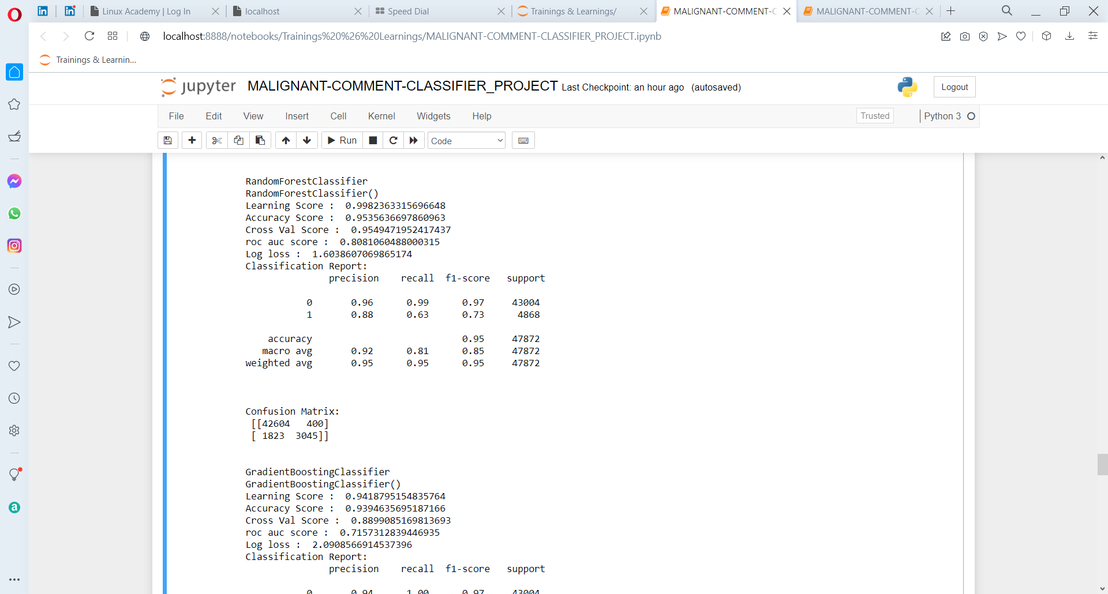
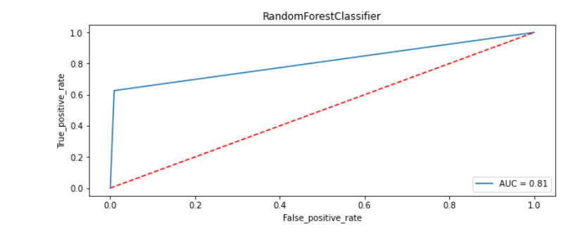
MODEL OUTPUT

Slide 31
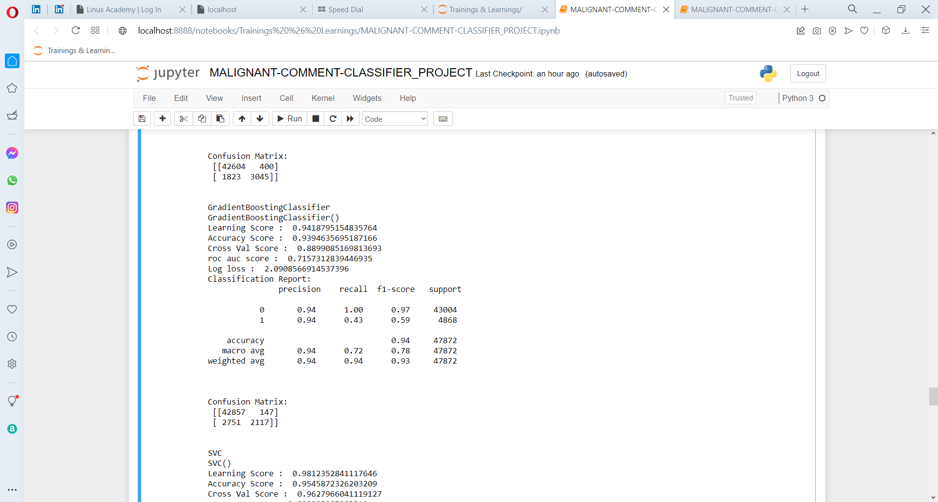
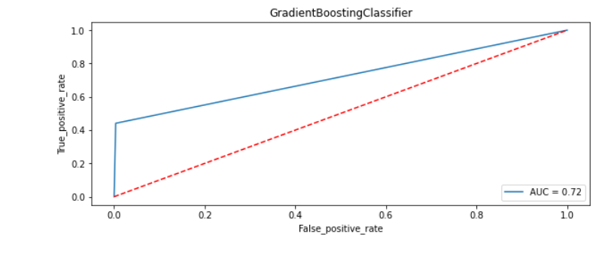
MODEL OUTPUT

Slide 32
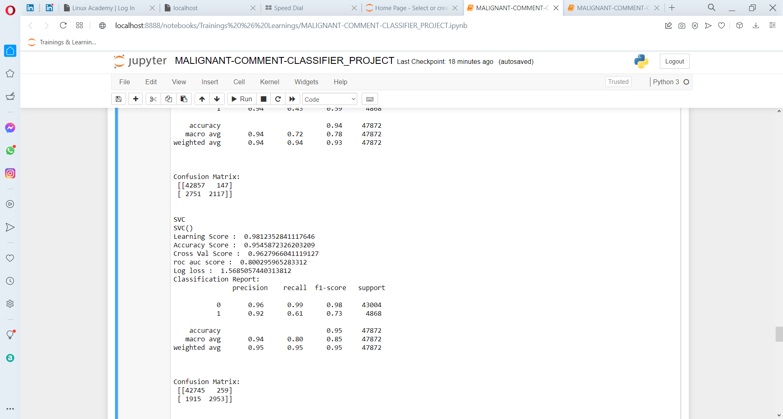
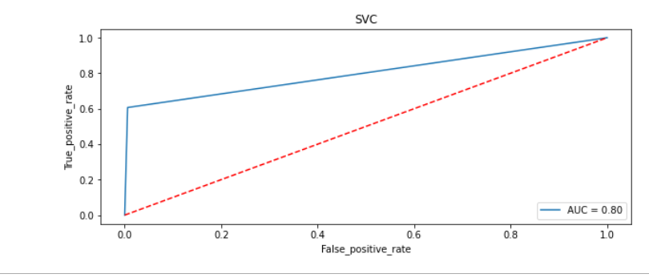
MODEL OUTPUT

Slide 33
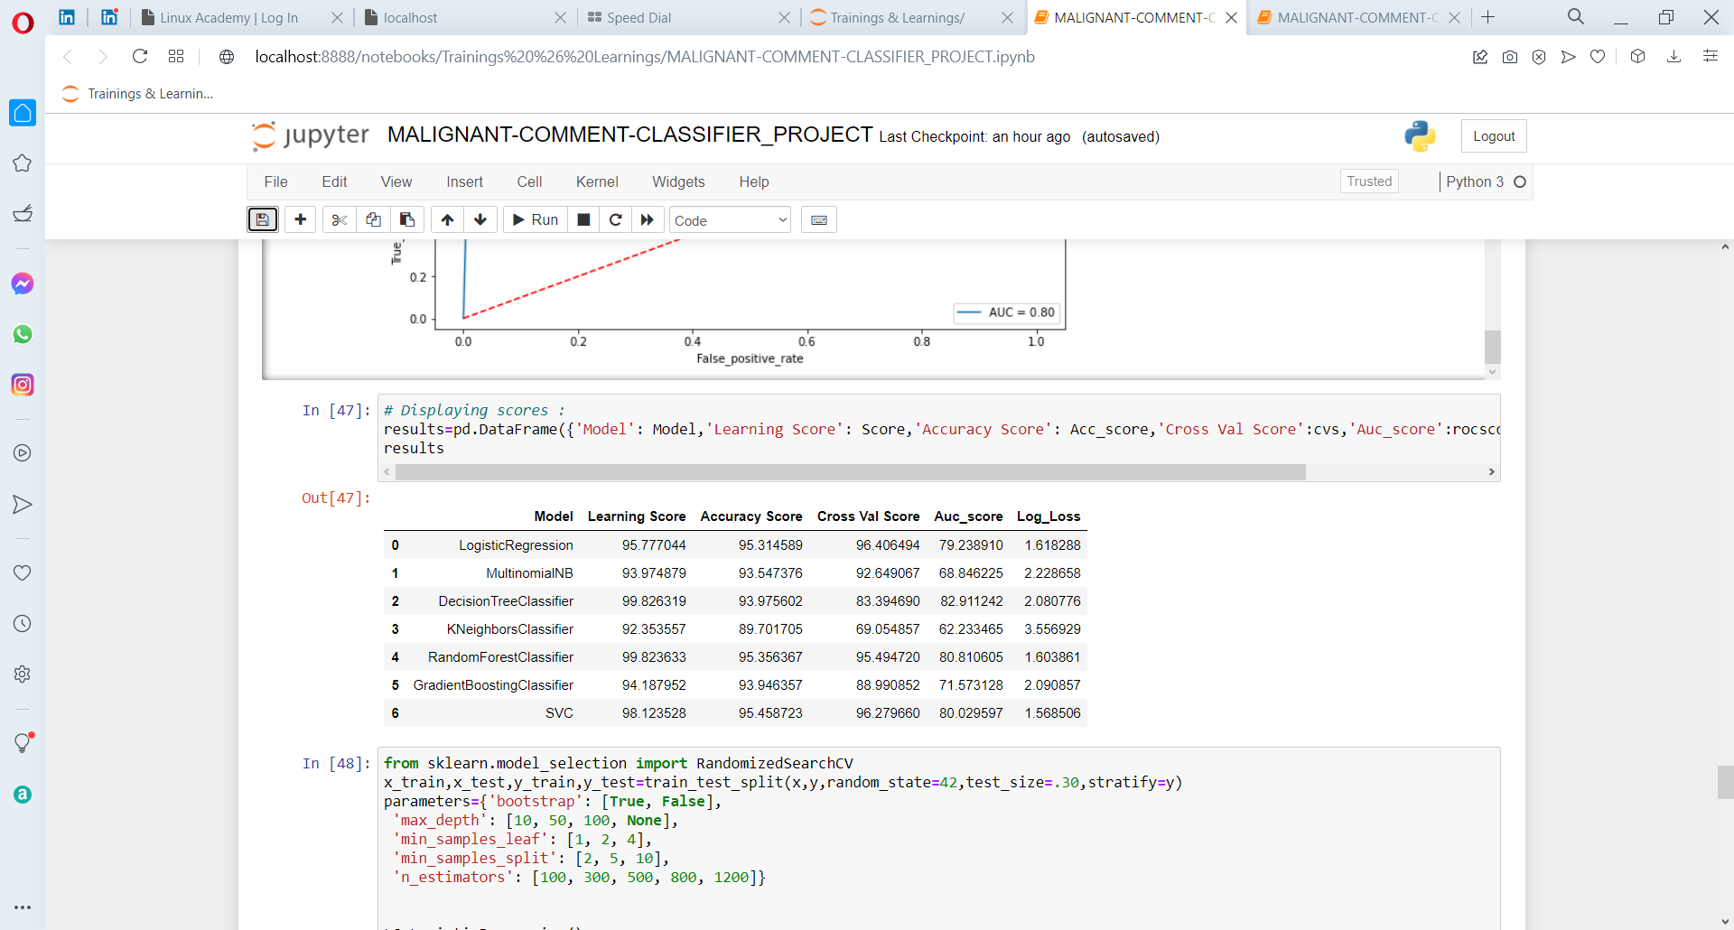
MODEL SCORES SUMMARY

Slide 34
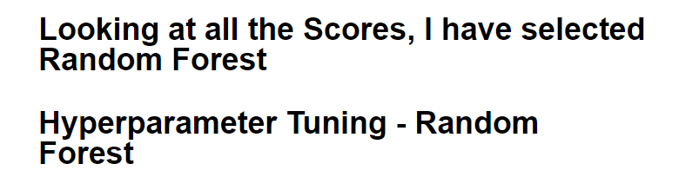
MODEL OUTPUT

Slide 35
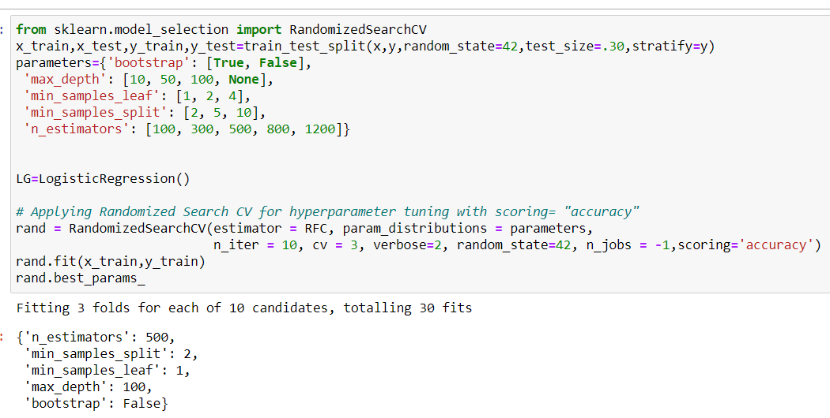
FINAL MODEL

Slide 36
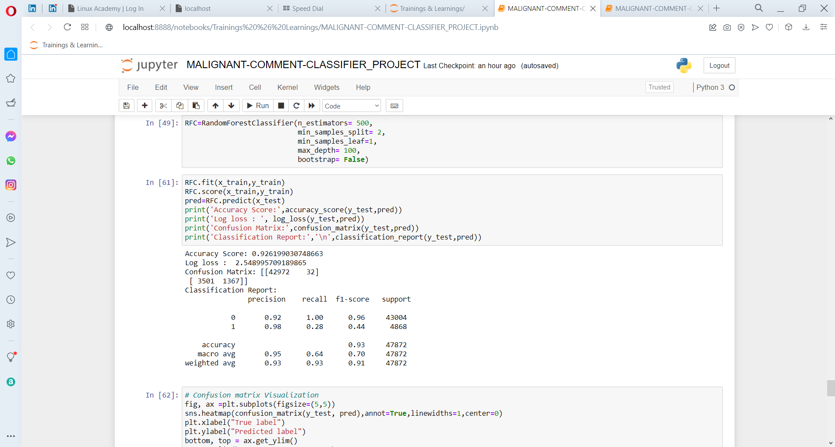
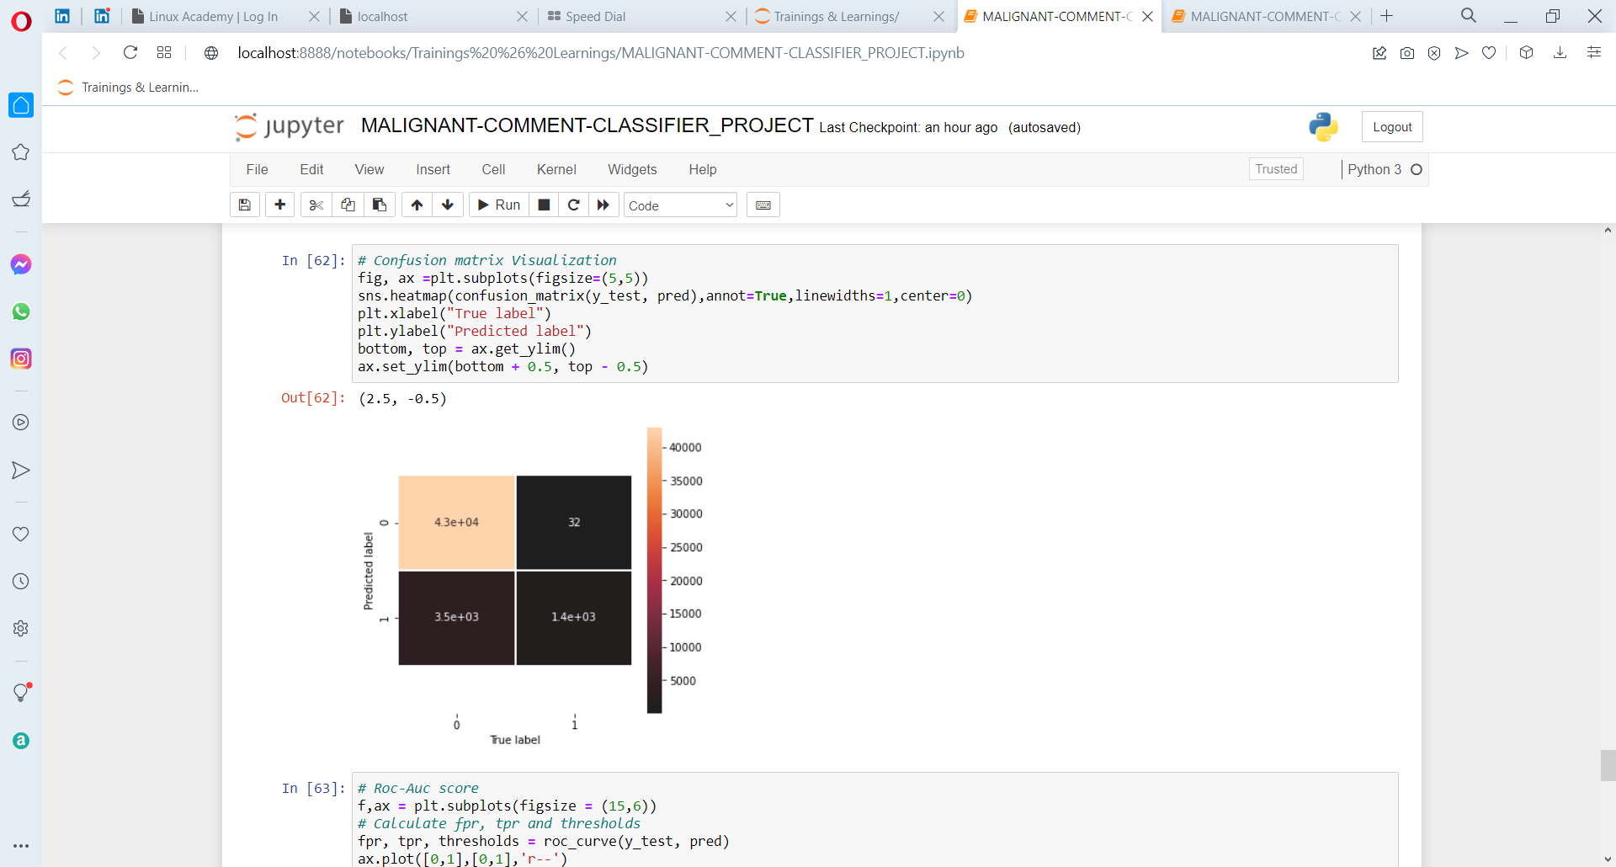
FINAL MODEL

Slide 37
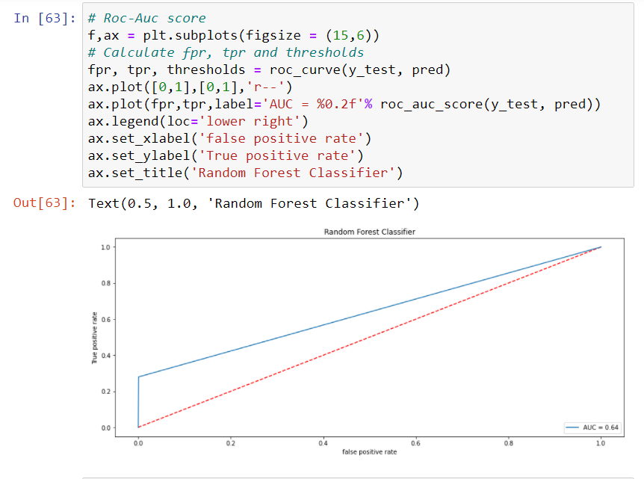
FINAL MODEL
The “clean comment text” feature has a notable reduction in the number of characters.

Slide 38
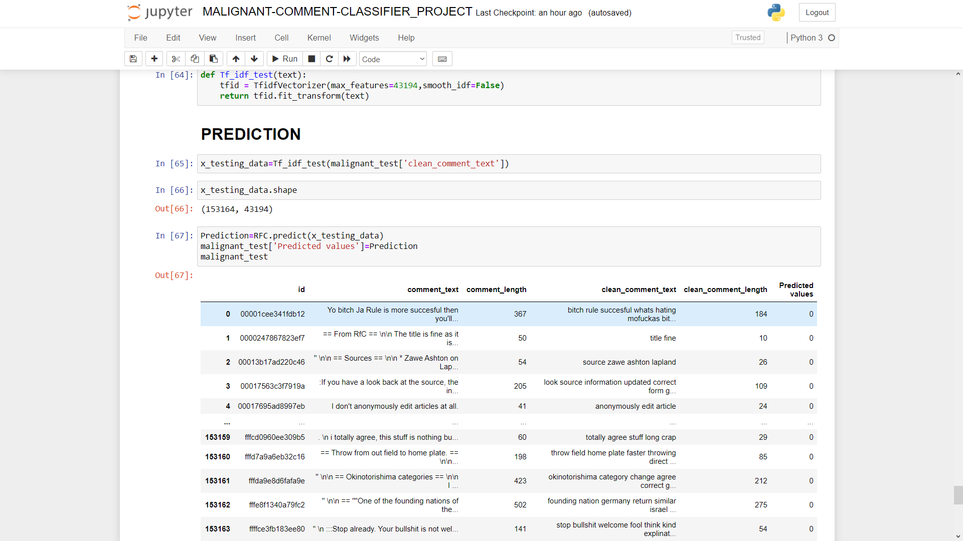
PREDICTED VALUES

Slide 39
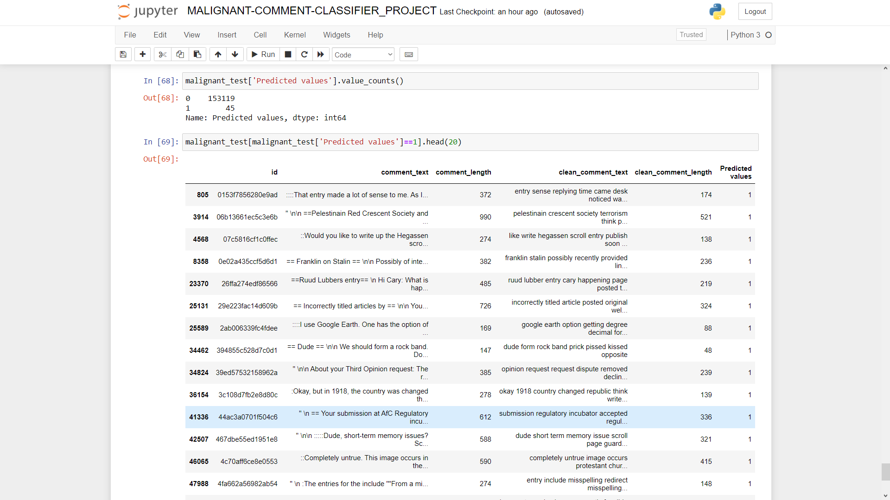
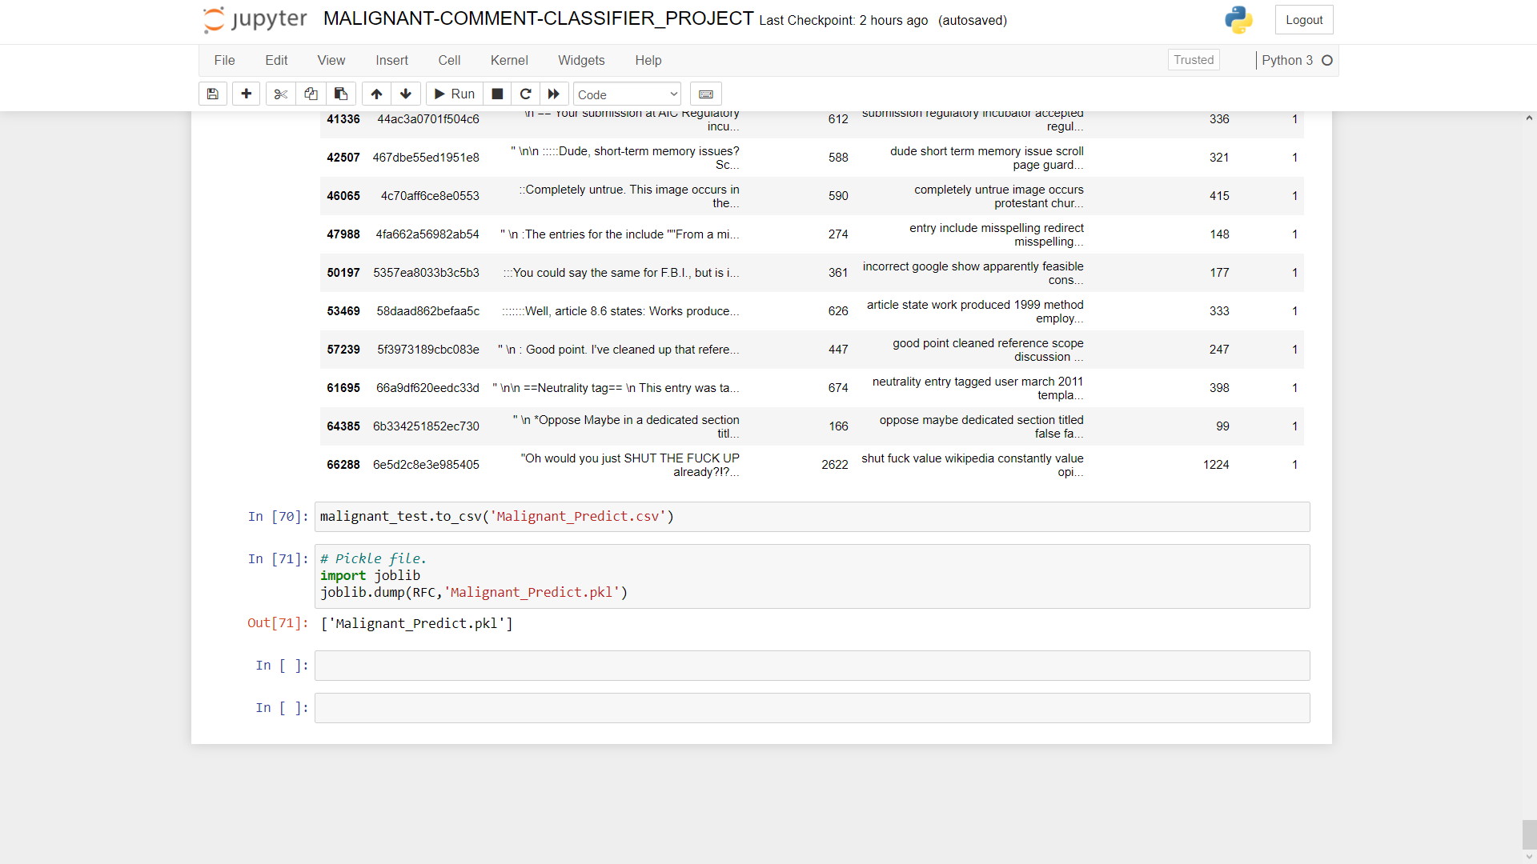
PREDICTED VALUES

Slide 40
CONCLUSION
Using a Random Forest Model, I have successfully predicted the comments given in the test data to be Negative vs Non-Negative (Positive and Neutral).
Limitations:
Some of the limitations can be:
The model might not be able to understand sarcasm.
Sometimes non-negative comments can be wrongly classified as negative ones, leading to loss of constructive feedback or comments.

Slide 41
CONCLUSION
KEY FINDINGS AND CONCLUSIONS OF THE STUDY
Online hate, described as abusive language, aggression, cyberbullying, hatefulness and many others has been identified as a major threat on online social media platforms. Social media platforms are the most prominent grounds for such toxic behaviour.
From the above analysis the below mentioned results were achieved which depicts the chances and conditions of a comment being a hateful comment or a normal comment.

Slide 42
CONCLUSION
With the increasing popularity of social media, more and more people consume feeds from social media and due differences they spread hate comments to instead of love and harmony. It has strong negative impacts on individual users and broader society.

